Slide 1
Spring Cloud Eureka
Service discovery

Slide 2
Service discovery in Microservices
A microservices-based application typically runs in virtualized or containerized environments. The number of instances of a service and its locations changes dynamically.
It is need to know where these instances are and their names to allow requests to arrive at the target microservice.
The Service Discovery mechanism helps us know where each instance is located. In this way, a Service Discovery component acts as a registry in which the addresses of all instances are tracked.
The instances have dynamically assigned network paths. Consequently, if a client wants to make a request to a service, it must use a Service Discovery mechanism.

Slide 3
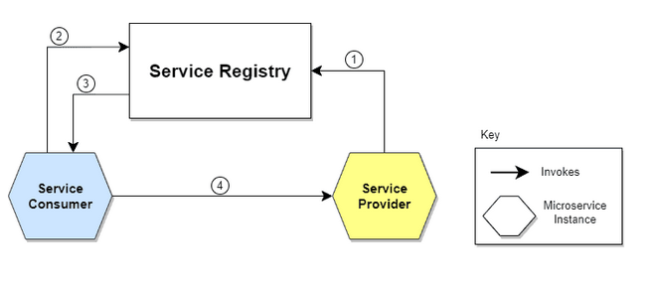
How Does Service Discovery Works?
Service Discovery handles things in two parts. First, it provides a mechanism for an instance to register and say, “I’m here!” Second, it provides a way to find the service once it has registered.

Slide 4
What is Microservices Load Balancing?
At its core, load balancing for microservices aims to distribute incoming network traffic across multiple instances of a service to ensure no single instance is overwhelmed with too much traffic. This results in:
Optimal Resource Utilization: Traffic distribution ensures that all service instances are used effectively.
Enhanced Application Availability: In the event that a service instance fails, traffic is rerouted to healthy instances.
Reduced Latency: Requests are directed to the nearest or quickest service instance, minimizing response times.

Slide 5
Spring Netflix Eureka
Spring Cloud Netflix provides Netflix OSS integrations for Spring Boot apps through autoconfiguration and binding to the Spring Environment and other Spring programming model idioms.
With a few simple annotations, you can quickly enable and configure the common patterns inside your application and build large distributed systems with battle-tested Netflix components.
The patterns provided include Service Discovery (Eureka).

Slide 6
Spring Netflix Eureka - Features
Spring Cloud Netflix features:
Service Discovery: Eureka instances can be registered and clients can discover the instances using Spring-managed beans
Service Discovery: an embedded Eureka server can be created with declarative Java configuration

Slide 7
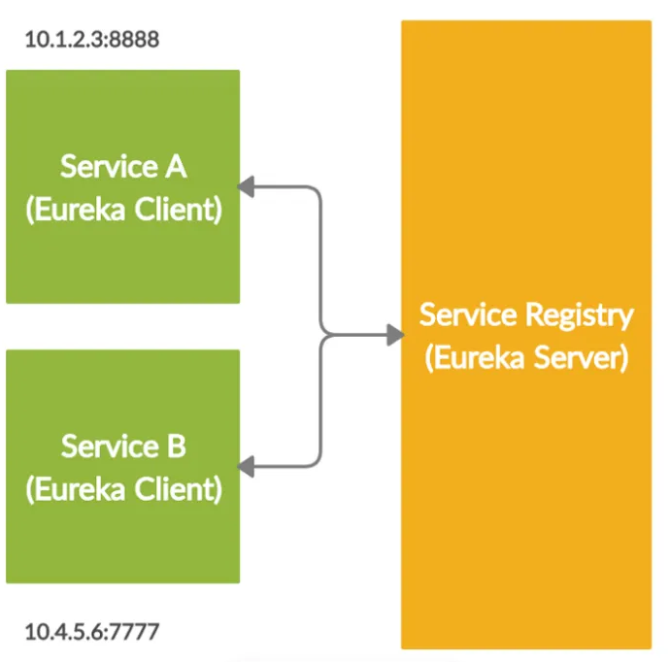
Spring Netflix Eureka
Eureka is a REST based service which is primarily used for acquiring information about services that you would want to communicate with. This REST service is also known as Eureka Server.
The Services that register in Eureka Server to obtain information about each other are called Eureka Clients.

Slide 8
Spring Netflix Eureka
Eureka mainly consists of main components, let’s see what they are: 1. Eureka Server: It is an application that contains information about all client service applications. Each microservice is registered with the Eureka server and Eureka knows all the client applications running on each port and IP address. Eureka Server is also known as Discovery Server.
2. Eureka Client: It’s the actual microservice and it registers with the Eureka Server, so if any other microservice wants the Eureka Client’s address then they’ll contact the Eureka Server.

Slide 9
Spring Netflix Eureka Server
Implementing a Eureka Server for service registry is as below:
Adding spring-cloud-starter-netflix-eureka-server to the dependencies
Enabling the Eureka Server in a @SpringBootApplication by annotating it with @EnableEurekaServer
Configuring some properties

Slide 10
Spring Netflix Eureka Client
For a @SpringBootApplication to be discovery-aware, we have to include a Spring Discovery Client (for example, spring-cloud-starter-netflix-eureka-client) into our classpath.
Then we need to annotate a @Configuration with either @EnableDiscoveryClient or @EnableEurekaClient. Note that this annotation is optional if we have the spring-cloud-starter-netflix-eureka-client dependency on the classpath.
The latter tells Spring Boot to use Spring Netflix Eureka for service discovery explicitly.

Slide 11

Lab: Working with Spring Service Registration and Discovery using Netflix Eureka
Lab Guide:
https://spring.io/guides/gs/service-registration-and-discovery

